Slide 1






Holdem
Azima qadirli, Murad Babayev, murad sadiqov

Slide 2


Holdem
HOLDEM is an e-commerce website designed for seamless online shopping. It enables users to browse and purchase products, manage their accounts, and interact through features like favorites, reviews, and a dynamic cart. Admins can manage users, products, categories, and orders efficiently. Built with Flask for the backend, MS SQL Server for the database, and a user-friendly frontend crafted with HTML, CSS, and JavaScript, HOLDEM ensures a smooth and interactive experience for both customers and administrators.
Azima qadirli, Murad Babayev, murad sadiqov

Slide 3

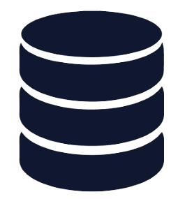

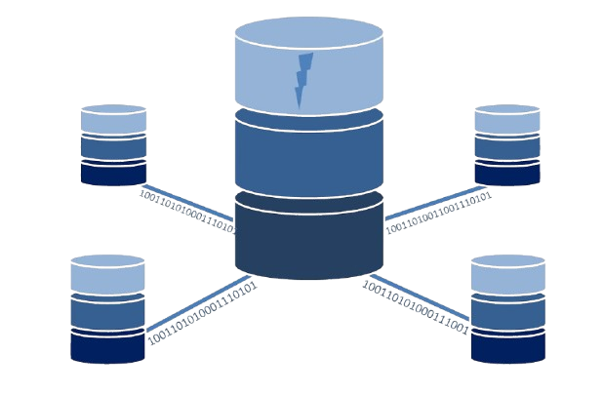



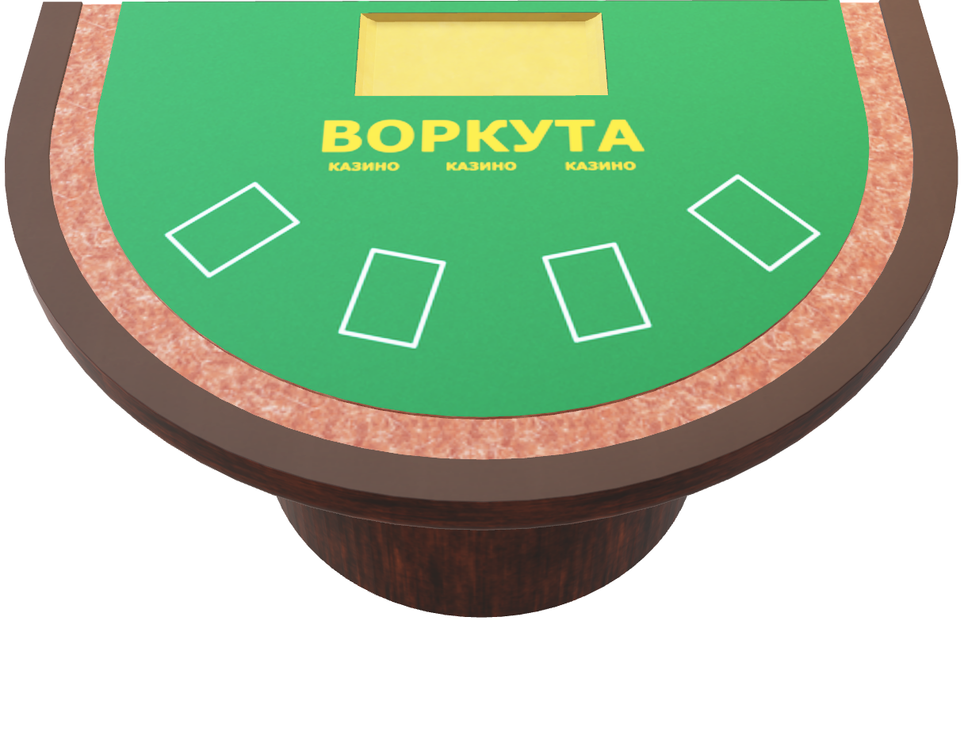


TECHNOLOGY
Backend
Database
FRONTEND
Db structure
Python Flask for server-side development and API handling.
MS SQL Server for managing structured data and relationships.
HTML, CSS, and JavaScript for creating an interactive user interface.
TABLES, RELATIONS, TRIGGERS, FUNCTION, PROCEDURES
MORE
MORE
APScheduler (3.11.0): Automates tasks like scheduling periodic events.
email_validator (2.2.0): Ensures email validation during user registration.
Flask (3.1.0): Core framework for handling routes, templates, and API.
Flask-Mail (0.10.0): Sends email notifications (e.g., account verification).
Flask-WTF (1.2.2): Simplifies form handling and validation.
Jinja2 (3.1.4): Templating engine for dynamic HTML generation.
pyodbc (5.2.0): Enables MS SQL Server database integration.
Werkzeug (3.1.3): Provides essential utilities for Flask.
WTForms (3.2.1): Streamlines form management and validation.
APScheduler (3.11.0): Automates tasks like scheduling periodic events.
email_validator (2.2.0): Ensures email validation during user registration.
Flask (3.1.0): Core framework for handling routes, templates, and API.
Flask-Mail (0.10.0): Sends email notifications (e.g., account verification).
Flask-WTF (1.2.2): Simplifies form handling and validation.
Jinja2 (3.1.4): Templating engine for dynamic HTML generation.
pyodbc (5.2.0): Enables MS SQL Server database integration.
Werkzeug (3.1.3): Provides essential utilities for Flask.
WTForms (3.2.1): Streamlines form management and validation.
MS SQL Server for managing structured data and relationships.
PROCEDURES
HTML, CSS, and JavaScript for creating an interactive user interface.
DIAGRAM
FUNCTIONS
TABLES
MORE
MORE
TRIGGERS
Back

Slide 4
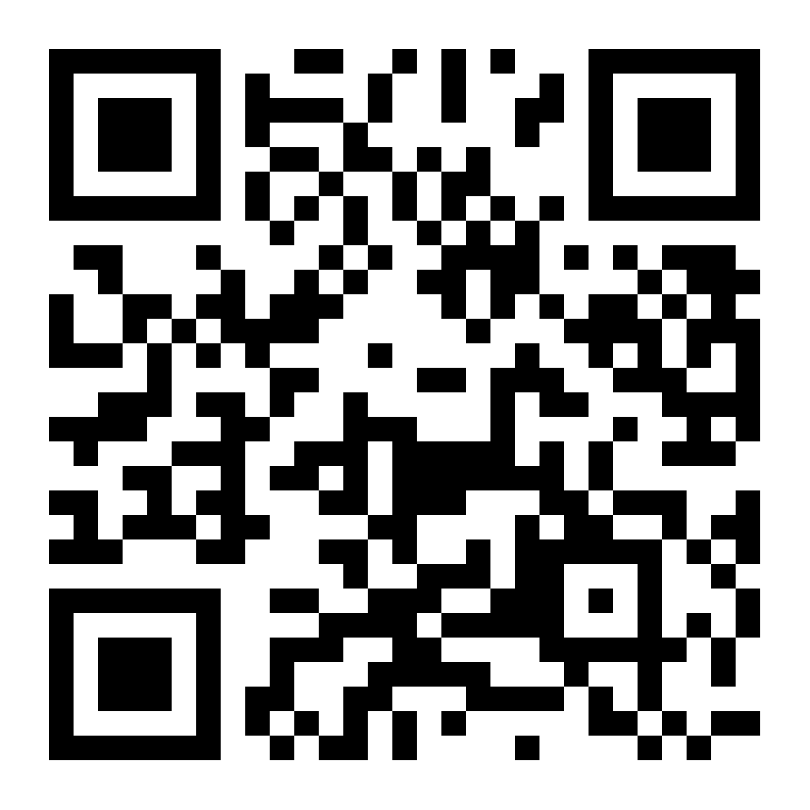
TECHNOLOGY
APScheduler (3.11.0): Automates tasks like scheduling periodic events.
email_validator (2.2.0): Ensures email validation during user registration.
Flask (3.1.0): Core framework for handling routes, templates, and API.
Flask-Mail (0.10.0): Sends email notifications (e.g., account verification).
Flask-WTF (1.2.2): Simplifies form handling and validation.
Jinja2 (3.1.4): Templating engine for dynamic HTML generation.
pyodbc (5.2.0): Enables MS SQL Server database integration.
Werkzeug (3.1.3): Provides essential utilities for Flask.
WTForms (3.2.1): Streamlines form management and validation.
Backend
Database
FRONTEND
Db structure
Python Flask for server-side development and API handling.
MS SQL Server for managing structured data and relationships.
HTML, CSS, and JavaScript for creating an interactive user interface.
TABLES, RELATIONS, TRIGGERS, FUNCTION, PROCEDURES
MORE
MORE
Back

Slide 5
TECHNOLOGY
APScheduler (3.11.0): Automates tasks like scheduling periodic events.
email_validator (2.2.0): Ensures email validation during user registration.
Flask (3.1.0): Core framework for handling routes, templates, and API.
Flask-Mail (0.10.0): Sends email notifications (e.g., account verification).
Flask-WTF (1.2.2): Simplifies form handling and validation.
Jinja2 (3.1.4): Templating engine for dynamic HTML generation.
pyodbc (5.2.0): Enables MS SQL Server database integration.
Werkzeug (3.1.3): Provides essential utilities for Flask.
WTForms (3.2.1): Streamlines form management and validation.
Backend
Database
FRONTEND
Db structure
Python Flask for server-side development and API handling.
MS SQL Server for managing structured data and relationships.
HTML, CSS, and JavaScript for creating an interactive user interface.
TABLES, RELATIONS, TRIGGERS, FUNCTION, PROCEDURES
MORE
MORE
Back

Slide 6

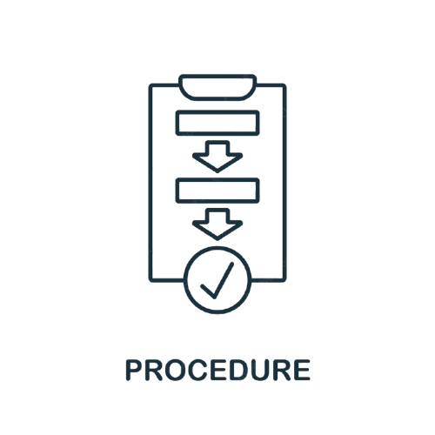



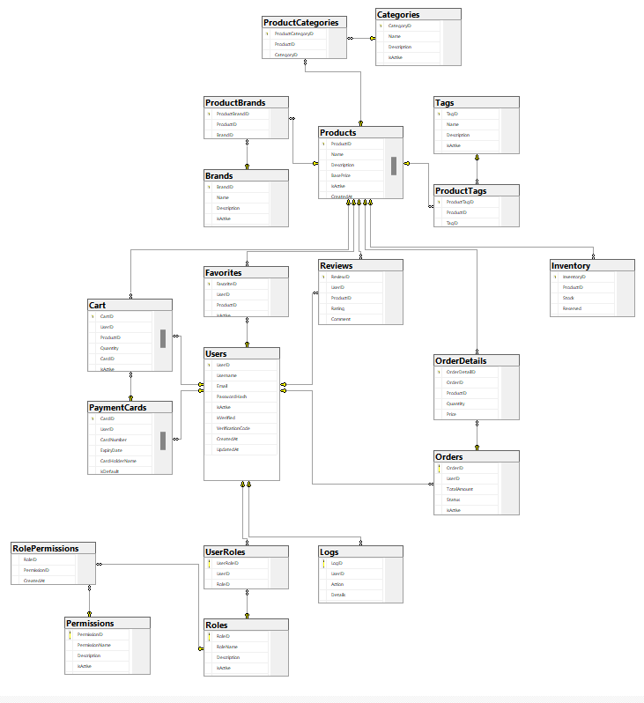
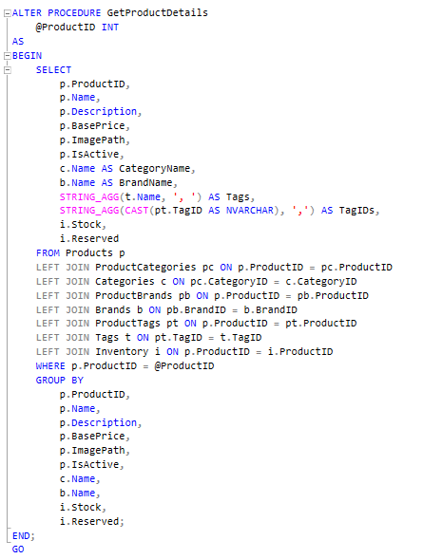
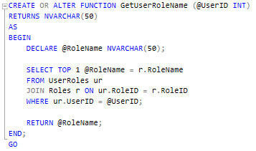
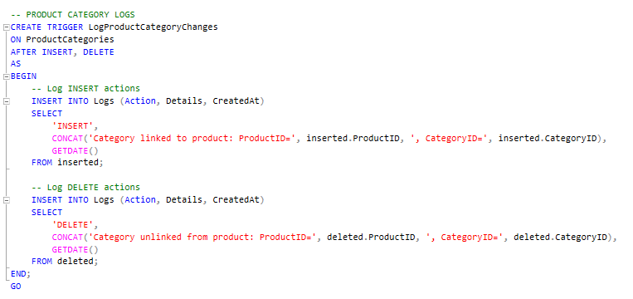
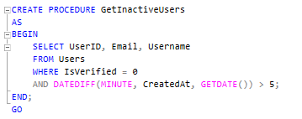
DB structure
Back
SQL scripts that perform predefined operations like fetching, inserting, updating, or deleting data.
special types of procedures that automatically execute in response to specific events on a table
Procedures
TRIGGERS
diagram
Functions
job
Tables & Relations
T-SQL routines that return a single value or table.
refers to a scheduled task or process that runs automatically at specified intervals or times.

Slide 7

DB structure
Back
SQL scripts that perform predefined operations like fetching, inserting, updating, or deleting data.
special types of procedures that automatically execute in response to specific events on a table
Procedures
TRIGGERS
diagram
Functions
job
Tables & Relations
T-SQL routines that return a single value or table.
refers to a scheduled task or process that runs automatically at specified intervals or times.

Slide 8
DB structure
Back
SQL scripts that perform predefined operations like fetching, inserting, updating, or deleting data.
special types of procedures that automatically execute in response to specific events on a table
Procedures
TRIGGERS
diagram
Functions
job
Tables & Relations
T-SQL routines that return a single value or table.
refers to a scheduled task or process that runs automatically at specified intervals or times.

Slide 9
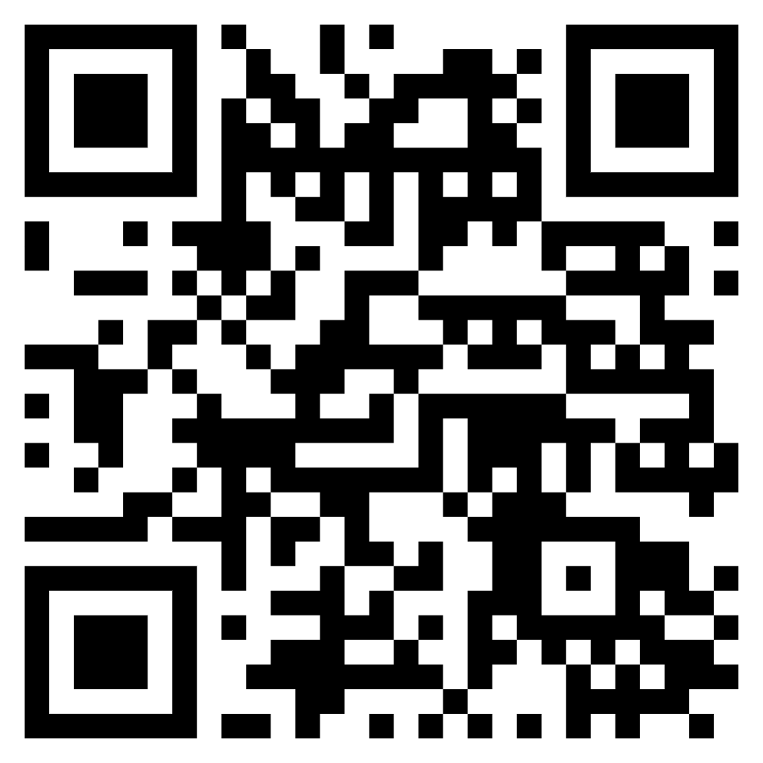
DB structure
Back
SQL scripts that perform predefined operations like fetching, inserting, updating, or deleting data.
special types of procedures that automatically execute in response to specific events on a table
Procedures
TRIGGERS
diagram
Functions
job
Tables & Relations
T-SQL routines that return a single value or table.
refers to a scheduled task or process that runs automatically at specified intervals or times.

Slide 10
DB structure
Back
SQL scripts that perform predefined operations like fetching, inserting, updating, or deleting data.
special types of procedures that automatically execute in response to specific events on a table
Procedures
TRIGGERS
diagram
Functions
job
Tables & Relations
T-SQL routines that return a single value or table.
refers to a scheduled task or process that runs automatically at specified intervals or times.

Slide 11
DB structure
Back
SQL scripts that perform predefined operations like fetching, inserting, updating, or deleting data.
special types of procedures that automatically execute in response to specific events on a table
Procedures
TRIGGERS
diagram
Functions
job
Tables & Relations
T-SQL routines that return a single value or table.
refers to a scheduled task or process that runs automatically at specified intervals or times.

Slide 12
DB structure
Back
SQL scripts that perform predefined operations like fetching, inserting, updating, or deleting data.
special types of procedures that automatically execute in response to specific events on a table
Procedures
TRIGGERS
diagram
Functions
job
Tables & Relations
T-SQL routines that return a single value or table.
refers to a scheduled task or process that runs automatically at specified intervals or times.

Slide 13
DB structure
Back
SQL scripts that perform predefined operations like fetching, inserting, updating, or deleting data.
special types of procedures that automatically execute in response to specific events on a table
Procedures
TRIGGERS
diagram
Functions
job
Tables & Relations
T-SQL routines that return a single value or table.
refers to a scheduled task or process that runs automatically at specified intervals or times.

Slide 14
DB structure
Back
SQL scripts that perform predefined operations like fetching, inserting, updating, or deleting data.
special types of procedures that automatically execute in response to specific events on a table
Procedures
TRIGGERS
diagram
Functions
job
Tables & Relations
T-SQL routines that return a single value or table.
refers to a scheduled task or process that runs automatically at specified intervals or times.

Slide 15
DB structure
Back
SQL scripts that perform predefined operations like fetching, inserting, updating, or deleting data.
special types of procedures that automatically execute in response to specific events on a table
Procedures
TRIGGERS
diagram
Functions
job
Tables & Relations
T-SQL routines that return a single value or table.
refers to a scheduled task or process that runs automatically at specified intervals or times.

Slide 16
DB structure
Back
SQL scripts that perform predefined operations like fetching, inserting, updating, or deleting data.
special types of procedures that automatically execute in response to specific events on a table
Procedures
TRIGGERS
diagram
Functions
job
Tables & Relations
T-SQL routines that return a single value or table.
refers to a scheduled task or process that runs automatically at specified intervals or times.

Slide 17




OUR TEAM
AZIMA QADIRLI
MURAD SADIQOV
MURAD BABAYEV

Slide 18


THANKS

